Slide 1
Sequential Logic Design

Slide 2
Introduction
Combinational Circuits
Without memory
Outputs depend only on current inputs
Output determined after sufficient time has elapsed
Sequential Circuits
Have memory
Outputs depend on inputs and previous outputs
Previous output stored even after waiting

Slide 3
Steady-State Abstraction
In reality, all real circuits are sequential
The outputs do not change instantaneously after an input change
A fundamental abstraction of digital design is to reason about steady-state behaviors
Look at outputs only after sufficient time has elapsed for the system to make its required changes and settle down
Memory of a system is represented as its state
Changes in system state are only allowed to occur at specific times

Slide 4


Simple Sequential Circuits
Two inverters form a static memory cell
The previous output is stored by passing it back into the system
Will hold value as long as it has power applied
How to get a new value into the memory cell?
Selectively break feedback path
Load new value into cell
"1"
"stored value"
"0"
"remember"
"load"
"stored value"
"data"

Slide 5
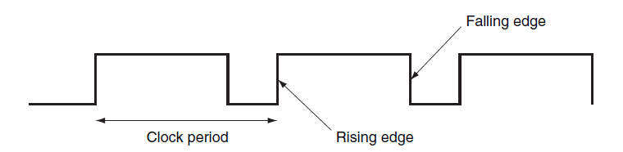
Clocks
Clocks are regular periodic signals
Clock period is divided into two portions
When the clock is “high”, also called the duty cycle
When the clock is “low”
State changes occur on a clock edge
When the clock moves from low to high or from high to low

Slide 6
Edge-Triggered Methodology
Either the rising edge or the falling edge is active
Determined by implementation
Does not affect design
Elements change on the active clock edge
All inputs sampled at the same time
All inputs must be valid (steady) at the active clock edge
Clocked systems are also called synchronous systems.

Slide 7
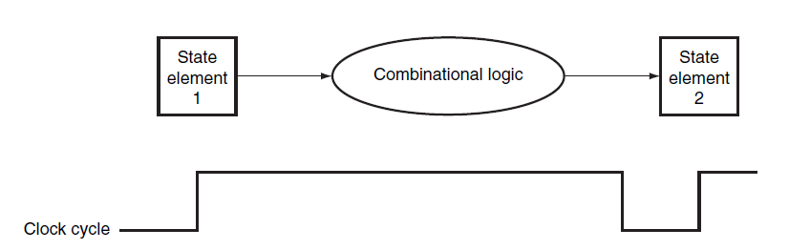
Sequential Logic Design
Combinational logic elements are still used
State elements provide valid inputs to the combinational logic block.
Clock period must be long enough to allow all the signals in the combinational logic block to settle

Slide 8
Sequential Circuits
Latches
Flip-flops
Registers

Slide 9
Latches
A latch is a memory element in which the output is equal to the value of the stored state inside the element and the state is changed whenever the appropriate inputs change.

Slide 10

Set-Reset Latch
Built from cross-coupled NOR gates
Ability to force output to 0 (reset=1) or 1 (set=1)
R
Q
S
Q'

Slide 11

Set-Reset Latch
Can also be build from cross-coupled NAND gates
NAND is a universal gate
Ability to force output to 0 (reset=0) or 1 (set=0)
S'
Q
Q'
R'

Slide 12
State Machines
A sequential circuit is described as a finite-state machine
A set of states
A function to determine the next state
A function to determine the output
Functions can still be represented by a truth table

Slide 13
Behavior of the S-R Latch
States: {hold, set, reset, unstable}
Next-State function:
S | R | State
0 | 0 | hold
0 | 1 | 0
1 | 0 | 1
1 | 1 | unstable

Slide 14
Behavior of the S-R Latch
States: {hold, set, reset, unstable}
Output function:
S | R | Qin | Qout
0 | 0 | 0 | 0
0 | 0 | 1 | 1
0 | 1 | 0 | 0
0 | 1 | 1 | 0
1 | 0 | 0 | 1
1 | 0 | 1 | 1
1 | 1 | 0 | ?
1 | 1 | 1 | ?

Slide 15
Behavior of the S-R Latch
State Diagram
States: possible outputs
Transitions: events that cause the system to change states (inputs)
SR=10
SR=00
SR=01
SR=00
SR=10
Q Q' 0 1
SR=01
Q Q' 1 0
SR=01
SR=10
SR=11
Q Q' 0 0
SR=11
SR=11
SR=00
SR=00
SR=01
SR=10
possible oscillation between states 00 and 11
Q Q' 1 1
SR=11

Slide 16
Behavior of the S-R Latch
Very difficult to observe R-S latch in the 1-1 state
One of R or S usually changes first
Ambiguously returns to state 0-1 or 1-0
A so-called "race condition"
Or non-deterministic transition
SR=10
SR=00
SR=01
SR=00
SR=10
Q Q' 0 1
SR=01
Q Q' 1 0
SR=01
SR=10
SR=11
Q Q' 0 0
SR=11
SR=11
SR=00
SR=00

Slide 17
Clocked S-R Latch
In an unclocked circuit the outputs change whenever the inputs change.
R
Q
S
Q'

Slide 18

Clocked S-R Latch
In a clocked circuit, we control when the inputs are sampled.
R'
R
Q
clock'
Q'
S'
S

Slide 19
Clocked S-R Latch
Controlling an R-S latch with a clock
Can't let R and S change while clock is active
Only have half of clock period for signal changes to propagate
Signals must be stable for the other half of clock period
R'
R
Q
stable
changing
stable
changing
stable
clock'
R' and S'
Q'
S'
clock
S

Slide 20
Flip-Flops
A flip-flop is a memory element for which the output is equal to the value of the stored state inside the element and for which the internal state is changed only on a clock edge.
Often built from clocked latches

Slide 21
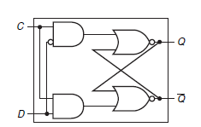
D Flip-Flop
2 Inputs
D, the data to be stored
C, the clock signal
2 Outputs
Q, the internal state
Q’, the complement of Q

Slide 22
D Flip-Flop
When the clock is asserted, the flip-flop is “open”
If D is 1, the S-R latch is “set”
If D is 0, the S-R latch is “reset”
When the clock is deasserted, the flip-flop is “closed”
The S-R latch is “holding”

Slide 23
D Flip-Flop
Flip-Flops can be built to trigger on either the rising or falling clock edge
Remember this does not affect the design
Flip-Flops can be build to trigger on the offset edge
If all Flip-Flops trigger on the positive edge, we can build one to trigger on the negative edge
We use cascading logic blocks

Slide 24
Cascading Logic Circuits
Connect output of one latch to input of another
How to stop changes from racing through chain?
Need to control flow of data from one latch to the next
Advance from one latch per clock period
R
R
Q'
R
Q'
S
S
Q
S
Q
clock

Slide 25
Master-Slave Structure
Break flow by alternating clocks
Use positive clock to latch inputs into one S-R latch
Use negative clock to change outputs with another S-R latch
View pair as one basic unit
master-slave flip-flop
twice as much logic
output changes a few gate delays after the falling edge of clock
master stage
slave stage
R
R
Q'
R
Q'
S
S
Q
S
Q
CLK

Slide 26
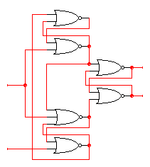
Negative Edge-Triggered Flip-Flops
More efficient solution: only 6 gates
D’
D
4-5 gate delays
Must respect setup and hold time constraints to successfully capture input
0
R
Q
Clk=1
Q’
S
0
D
D’

Slide 27
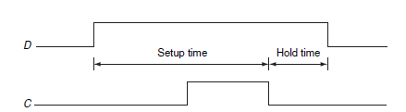
Timing Methodologies
The set up time is the minimum time that the input must be valid before the clock edge.
The hold time is the minimum time during which it must be valid after the clock edge.

Slide 28
Timing Methodologies
Rules for interconnecting components and clocks
Guarantee proper operation of system when strictly followed
Approach depends on building blocks used for memory elements
Focus on systems with edge-triggered flip-flops
Basic rules for correct timing:
(1) Correct inputs, with respect to time, are provided to the flip-flops
(2) No flip-flop changes state more than once per clocking event

Slide 29
Typical Timing Specifications
Positive edge-triggered D flip-flop
Setup and hold times
Minimum clock width
Propagation delays (low to high, high to low, max and typical)
D
Tsu 20ns
Th 5ns
Tsu 20ns
Th 5ns
CLK
Tw 25ns
Tplh 25ns 13ns
Tphl 40ns 25ns
Q
all measurements are made from the clocking event: the rising edge of the clock

Slide 30
Cascading Edge-triggered Flip-Flops
Consider setup/hold/propagation delays
prop must be > hold
Q0
Q1
IN
D
Q
D
Q
OUT
CLK
100
IN
Q0
Q1
CLK

Slide 31
Clock Skew
Correct behavior assumes next state of all storage elements determined by all storage elements at the same time
This is difficult in high-performance systems because time for clock to arrive at flip-flop is comparable to delays through logic
Clock skew is the difference in time between when two state elements see a clock edge

Slide 32
Clock Skew
If the clock skew is large enough, it may be possible for a state element to change and cause the input to another flip-flop to change before the clock edge is seen by the second flip-flop.
To avoid incorrect operation, we must increase the clock period to allow for the maximum clock skew.
100
In
Q0
Q1
CLK0
CLK1
CLK1 is a delayed
version of CLK0
original state: IN = 0, Q0 = 1, Q1 = 1
due to skew, next state becomes: Q0 = 0, Q1 = 0, and not Q0 = 0, Q1 = 1

Slide 33
Asynchronous Inputs
Clocked synchronous circuits
Inputs, state, and outputs sampled or changed in relation to a common reference signal (called the clock)
Asynchronous circuits
Inputs, state, and outputs sampled or changed independently of a common reference signal
Some system inputs must be asynchronous
reset signal, memory wait, user input
Unstable states are a major concern
Asynchronous inputs to synchronous circuits
Because synchronous inputs are greatly preferred, we use a synchronizer

Slide 34
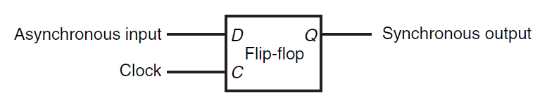
Synchronizer
Use a synchronizer to translate asynchronous input
An asynchronous input will remain “asserted” until acknowledged

Slide 35
Synchronizer
What happens if the asynchronous input is transitioning between 0 and 1?
The signal is not stable for the required setup and hold times
The synchronizer may enter a metastable state
The output will be neither 0 or 1
This situation is called synchronizer failure

Slide 36
Synchronization Failure
Probability of failure can never be reduced to 0, but it can be reduced:
slow down the system clock: this gives the synchronizer more time to decay into a steady state; synchronizer failure becomes a big problem for very high speed systems
use fastest possible logic technology in the synchronizer: this makes for a very sharp "peak" upon which to balance
cascade two synchronizers: this effectively synchronizes twice (both would have to fail)
asynchronous
input
D
Q
Q
synchronized
input
D
Clk
synchronous system

Slide 37
Handling Asynchronous Inputs
Never allow asynchronous inputs to fan-out to more than one flip-flop
Synchronize as soon as possible and then treat as synchronous signal
Clocked
Synchronizer
Synchronous
System
Async
Q0
Async
D
Q
D
Q
Q0
Input
D
Q
Input
Clock
Clock
D
Q
Q1
D
Q
Q1
Clock
Clock

Slide 38
Registers
Collections of flip-flops with similar controls and logic
Stored values somehow related (e.g., form binary value)
Share clock, reset, and set lines
Similar logic at each stage
Examples
Shift registers
Counters
OUT1
OUT2
OUT3
OUT4
"0"
R
S
R
S
R
S
R
S
D
Q
D
Q
D
Q
D
Q
CLK
IN1
IN2
IN3
IN4

Slide 39
Shift Register
Holds samples of input
Store last 4 input values in sequence
4-bit shift register:
OUT1
OUT2
OUT3
OUT4
IN
D
Q
D
Q
D
Q
D
Q
CLK

Slide 40
Universal Shift Register
Holds 4 values
Serial or parallel inputs
Serial or parallel outputs
Permits shift left or right
Shift in new values from left or right
output
clear sets the register contents and output to 0 s1 and s0 determine the shift function s0 s1 function 0 0 hold state 0 1 shift right 1 0 shift left 1 1 load new input
left_in
right_out
left_out
right_in
clear
s0
clock
s1
input

Slide 41
Design of Universal Shift Register
Consider one of the four flip-flops
New value at next clock cycle:
Nth cell
to N-1th cell
to N+1th cell
Q
D
CLK
clear s0 s1 new value 1 – – 0 0 0 0 output 0 0 1 output value of FF to left (shift right) 0 1 0 output value of FF to right (shift left) 0 1 1 input
CLEAR
0
1
2
3
s0 and s1 control mux
Q[N-1] (left)
Q[N+1] (right)
Input[N]

Slide 42
Pattern Recognizer
Combinational function of input samples
In this case, recognizing the pattern 1001 on the single input signal
OUT
OUT1
OUT2
OUT3
OUT4
IN
D
Q
D
Q
D
Q
D
Q
CLK

Slide 43
Counters
Sequences through a fixed set of patterns
In this case, 1000, 0100, 0010, 0001
If one of the patterns is its initial state (by loading or set/reset)
Mobius (or Johnson) counter
In this case, 1000, 1100, 1110, 1111, 0111, 0011, 0001, 0000
OUT1
OUT2
OUT3
OUT4
IN
D
Q
D
Q
D
Q
D
Q
CLK
OUT1
OUT2
OUT3
OUT4
IN
D
Q
D
Q
D
Q
D
Q
CLK

Slide 44
Register Files
A register file consists of a set of registers that can be read and written by supplying a register number to be accessed.

Slide 45
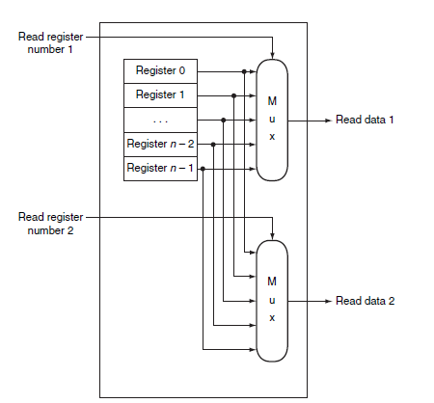
Register Files: Read

Slide 46
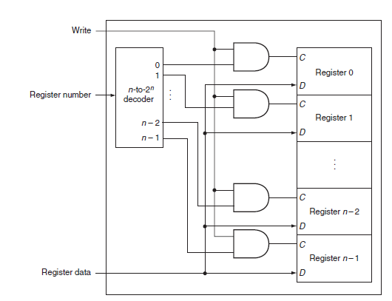
Register Files: Write

